Slide 1






Aeroelastic modeling and analysis of aircraft wings with distributed electric propulsors: Wing-Body and Box-Wing Configurations
Seyed Ahmad Fazelzadeh¹,
Abbas Mazidi², Afshin Banazadeh³,Mohammad Reza Amoozgar⁴
Shiraz University¹, Yazd University²,
Sharif University of Technology³
Nottingham University⁴
Fazelzad@shirazu.ac.ir
July 20, 2022

Slide 2
OUTLINE
Introduction
Distributed Electric Propulsion System
Persian Sky Program
Wing-body aeroelasticity
Aeroelasticity of wings with distributed electric propulsion
Aeroelasticity of box-wings
Conclusion
Fazelzadeh et al

Slide 3
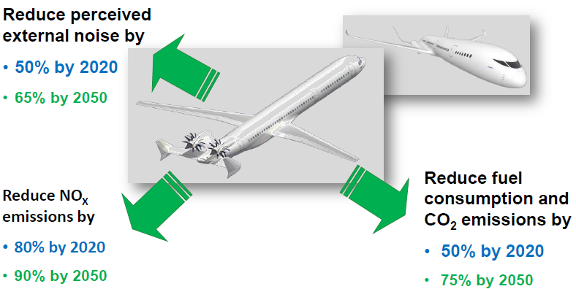
Introduction
Green Aviation
Research into green aviation technology, including reduced noise and emissions has grown quickly in recent years.
Several new technology ideas are being investigated by aircraft designers, such as distributed propulsion wings.
Fazelzadeh et al

Slide 4
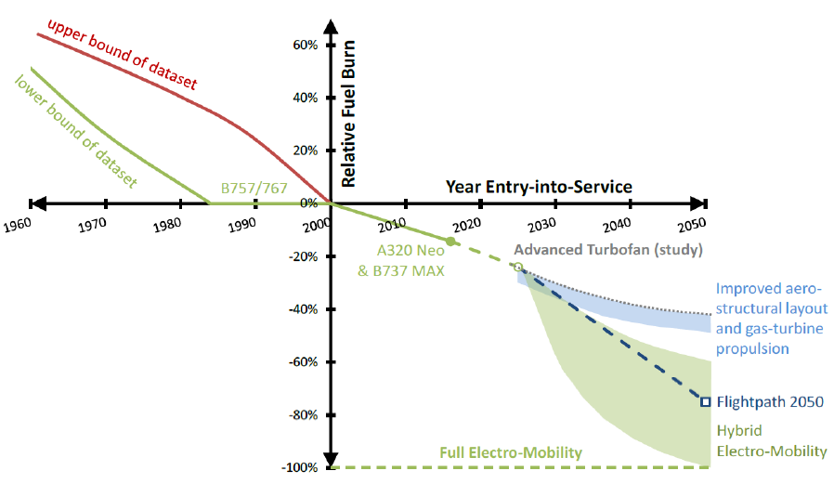
Introduction
After 2025, with fuel saving around 25-30% due to advanced turbofan studies, extra improvement is expected using electric propulsion.
Fuel burn reduction expectation with respect to year 2000
(Brelje and Martins, 2018)
Fazelzadeh et al

Slide 5
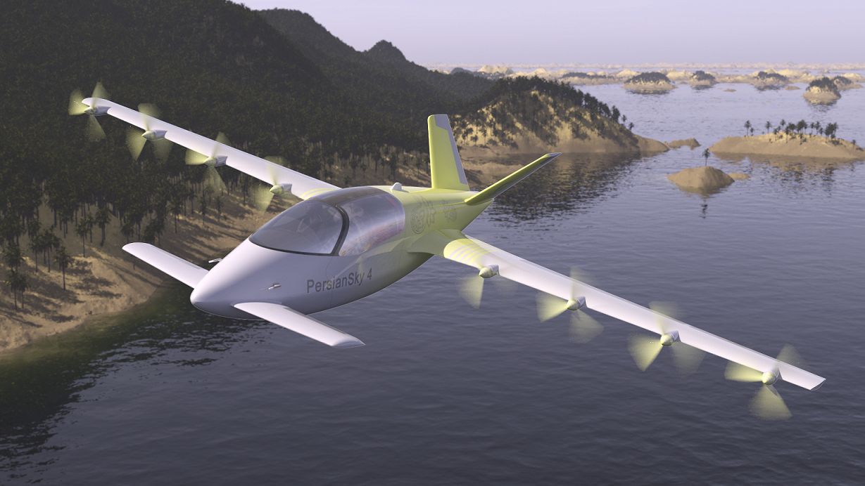
Distributed electric propulsion System
Distributed electric propulsion involves distributing electric motors and associated propulsions along the aircraft wing.
Distributed electric propulsion can improve performance in noise reduction, aerodynamic efficiency and flight safety.
Persian Sky IV Full Electric Aircraft
Fazelzadeh et al

Slide 6
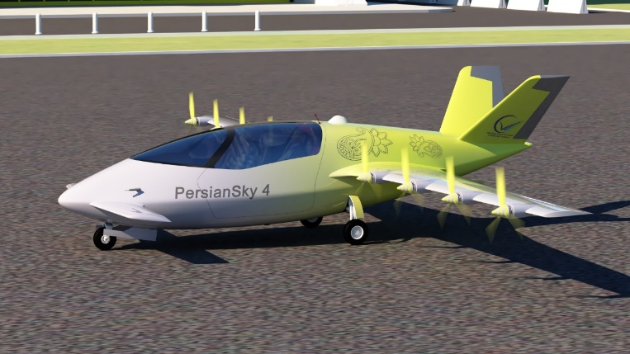
Distributed electric propulsion System
Advantages of Distributed Electric Propulsion (DEP) Aircrafts
Shorter take-off and landing distances (STOL)
Low power and efficient flight
Green aviation benefits ( Low noise and Zero-emission)
Accurate navigation and flight control.
Reliable and redundant propulsion units
Low maintenance and operation costs
Increase L/D ratio
Capability of extension
Fazelzadeh et al

Slide 7
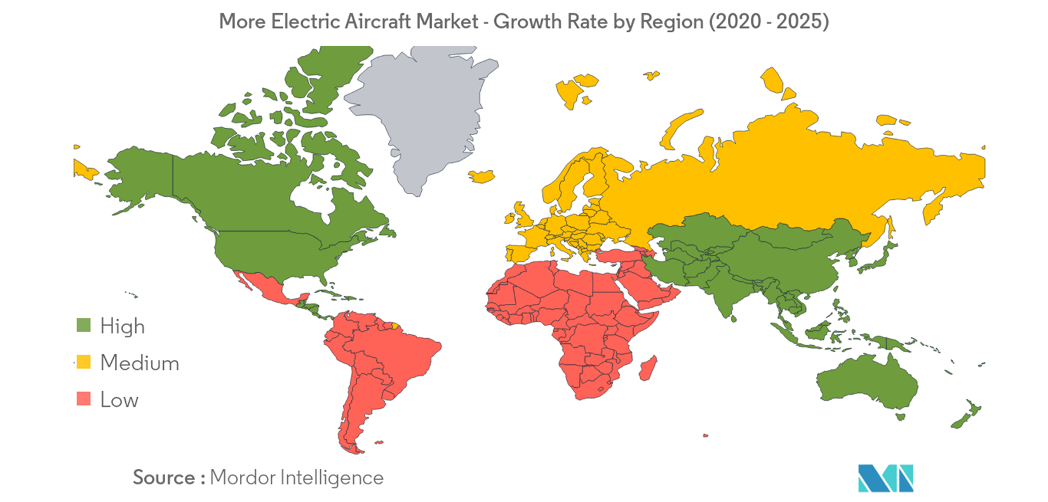
Persian Sky Program
Persian Sky program consists of feasibility studies, research process, conceptual, preliminary and detail design, technology development of distributed electric propulsion (DEP) regional aircrafts. The program started back in 2015 at Sky-High Smart Structure Technology (3STC) Iranian start-up company.
The attribute of this technological program is to implement leading-edge electrical aircraft propulsion technologies as well as advance materials of aircraft structure, navigation and control strategies in order to achieve a next generation aircraft.
Fazelzadeh et al

Slide 8

Persian Sky Program
Persian Sky is a family of all-electric air taxies commuting between nearby cities and short distances. With its state-of-art, distributed electric propulsion (DEP) system and its composite structure, Persian sky can provide affordable and safe flight for intercity transport.
Thanks to its electric motors and Lithium Ion Battery packs, Persian Sky has zero carbon emissions and can be recharged in a short time.
Our Research team has been developed Persian Sky Program with international network.
Persian Sky Program
2020-2035
Fazelzadeh et al

Slide 9
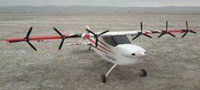
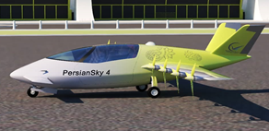
Persian Sky 0 is an experimental RC Model being developed by 3S-T stratup Company, intended to demonstrate the distributed propulsion technology benefits.(2019-2020).
Persian Sky II can carry two passengers over an extended range of 150km. Test flights were initially planned to commence in 2025.
Persian Sky IV can carry four passengers over an extended range of 150km. Test flights were initially planned to commence in 2028. First flight is expected in 2030.
Fazelzadeh et al

Slide 10
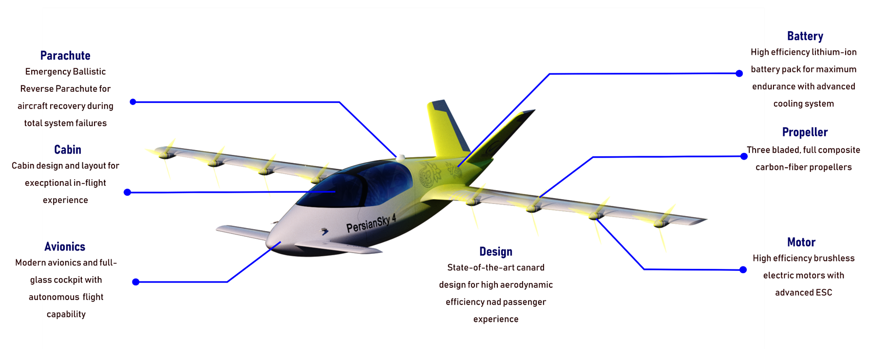
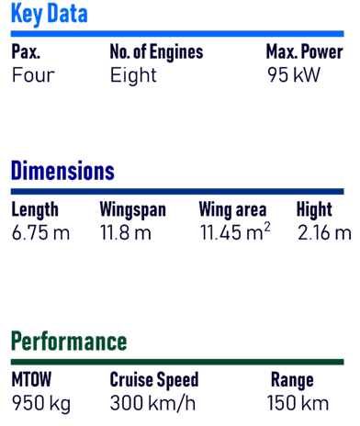
Persian Sky Program: PS-IV
Fazelzadeh et al

Slide 11
Wing Aeroelaticity: Literature Review
Advanced Wing Aeroelasticity
Fazelzadeh S. A., Marzocca P, Mazidi A, Rashidi E (2010) Effects of Rolling Maneuver on Divergence and Flutter of Wing-Store, AIAA Journal of Aircraft 47:64-70
Fazelzadeh S. A., Mazidi A (2011) Nonlinear aeroelastic analysis of bending-torsion wings subjected to a transverse follower force, ASME- Computational and Nonlinear Dynamics 6:310161-310168
Pezhman Mardanpour, Ehsan Izadpanahiy, Siavash Rastkar, S. A. Fazelzadeh, Dewey H. Hodges (2018), Geometrically-exact, fully intrinsic analysis of pretwisted beams under distributed follower forces, AIAA Journal, Vol. 56, No. 2 , pp. 836-848.
S. Ahmad Fazelzadeh, Mohsen Rezaei, Abbas Mazidi, Aeroelastic Modeling of Aircraft Wings taking into Account Variations in Wing Geometry (2020), Journal of Fluids and Structures, 95 (2020) 103001 (18 pages).
M.R. Amoozgar , S.A. Fazelzadeh , H. Haddad Khodaparast , M.I. Friswell , J. E. Cooper , Aeroelastic stability analysis of aircraft wings with initial curvature (2020), Aerospace Science and Technology . 107, 106241.
Mohsen Rezaei, S. Ahmad Fazelzadeh, Abbas Mazidi, Michael I. Friswell, Hamed H. Khodaparast (2020), Fuzzy Uncertainty Analysis and Reliability Assessment of Aeroelastic Aircraft Wings, The Aeronautical Journal, (2020), Vol. 124, Issue 1275 ,May 2020 , pp. 786-811.
Fazelzadeh et al

Slide 12
Wing Aeroelaticity: Literature Review
Wing-body Aeroelasticity: Single and Twin-Powered-Engines
Fazelzadeh S. A., Mazidi A, Kalantari H (2009) Bending-Torsional flutter of wings with an attached mass subjected to a follower force, Journal of Sound and Vibration 323:148-162
Mazidi A, Fazelzadeh S. A. (2010) Flutter of a swept aircraft wing with a powered-engine, ASCE-Journal of Aerospace Engineering 23:243-250
Sadat Hoseini Khajuee S, Fazelzadeh S. A., Rasti jahromi A, Marzocca P (2013) Final Approach and Flare Control of a Flexible Aircraft in Crosswind Landings, Journal of Guidance, Control, and Dynamics 36:946-957.
Mazidi A, Fazelzadeh S. A. (2011) Aeroelastic Modeling and Flutter Prediction of Swept Wings Carrying Twin-Powered-Engines, ASCE-Journal of Aerospace Engineering 25:1-12
Mazidi A, Kalantari H, Fazelzadeh S. A. (2013) Aeroelastic Response of an Aircraft Wing with Mounted Engine Subjected to Time-Dependent thrust, Journal of Fluids and Structures 39:292-305
Fazelzadeh et al

Slide 13
Aeroelasticity
Wing-body aeroelasticity
Engine Mass
Engine mass and inertia can affect the wing aeroelastic instability boundary.
Effects of the engine mass on the flutter boundary of an aircraft wing for different values of the wing sweep angle.
Fazelzadeh et al

Slide 14
Wing-body aeroelasticity
Engine Trust
The dynamic coupling between unsteady aerodynamic loads and engine thrust with the structure motion may cause unstable dynamic motions of the wing with increasing amplitude which are known as flutter phenomena.
Effects of engines trust on the wing flutter boundary
Fazelzadeh et al

Slide 15
Wing-body aeroelasticity
Engine Location
Engine mounting locations have significant effects on the aeroelastic behavior of the wing.
Increasing the distance of the engine from the wing root will decrease the flutter speed.
The instability takes place at zero air velocity for large values of the engine thrust when the engine slides to the wing tip.
Fazelzadeh et al

Slide 16
Wing-body aeroelasticity
Sliding the engine toward the front of the wing will increase the flutter speed, generally.
The trend of variation of the flutter speed versus the downward position of the engine is similar to the one for upward position of the engine
Fazelzadeh et al

Slide 17
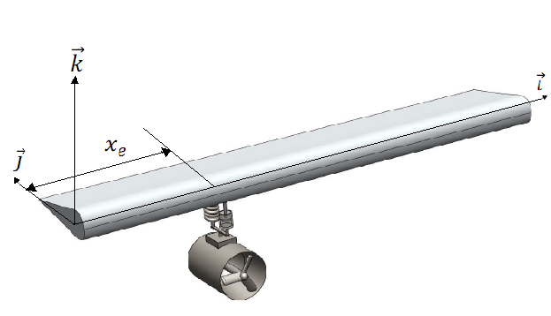
Wing-body aeroelasticity
Wing-Engine Connection
The rigidity and damping properties of wing-engine connection have influences on the wing aeroelastic characteristics.
Fazelzadeh et al

Slide 18
Wing-body aeroelasticity
Engine Blades Rotation
Engine blades rotational speed cause gyroscopic effects in system and hence the wing flutter speed varies with engine blades rotational speed.
Increasing the engine blades rotational speed will decrease the wing flutter speed.
Fazelzadeh et al

Slide 19
DEP Wing Aeroelaticity: Literature Review
Distributed Electric Propulsion Aircraft Wings
S. Ahmad Fazelzadeh , A. Mazidi, Jonathan E. Cooper, Dewey. H. Hodges, John E. Mottershead, Flutter Analysis of Distributed Electric Propulsion Aircraft Wings, International Symposium on Sustainable Aviation 2019, 26 – 29 May 2019, Budapest, Hungary
M.R. Amoozgar, S.A. Fazelzadeh, A. Mazidi , H. Haddad Khodaparast, M.I. Friswell, Aeroelastic Analysis of Electric Aircraft Wings Subjected to Propeller Thrust and Angular Momentum, Aerospace Europe Conference 2020, Bordeaux, France, 25-28 February 2020.
Mohammadreza Amoozgar, Michael I. Friswell, S. Ahmad Fazelzadeh, Hamed Haddad Khodaparast, Abbas Mazidi, Jonathan E. Cooper, Aeroelastic stability analysis of electric aircraft wings with distributed electric propulsors (2021), Aerospace 2021, 8(4), 100; https://doi.org/10.3390/aerospace8040100
Fazelzadeh et al

Slide 20
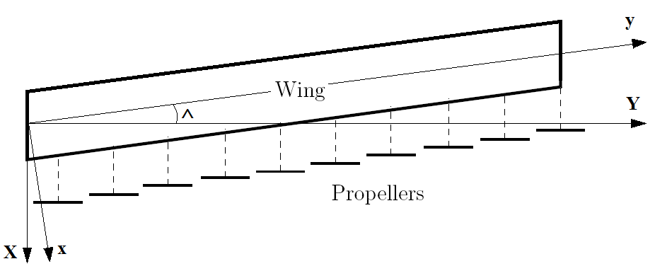
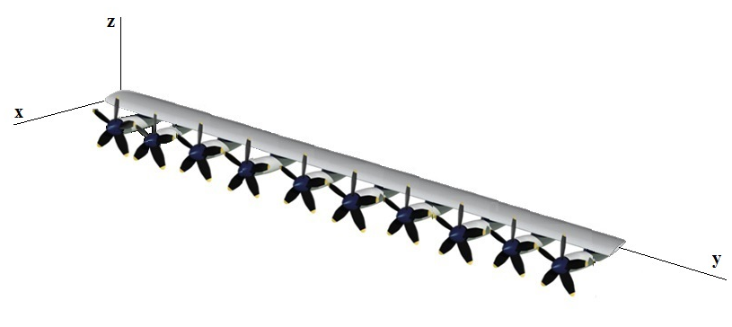
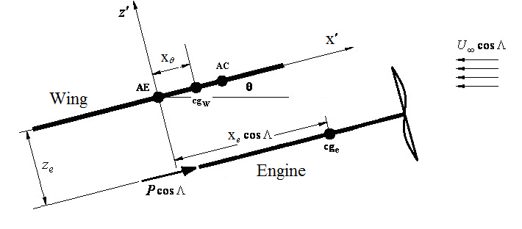
Aeroelasticity of wings with distributed propulsion
Schematic of a swept wing with distributed electric propulsion
Fazelzadeh et al

Slide 21
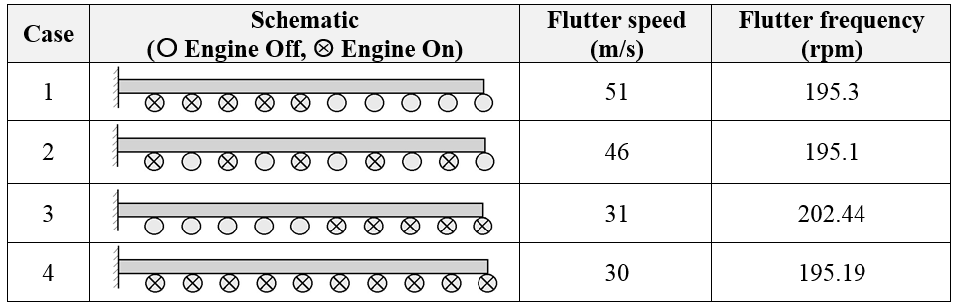
Aeroelasticity of wings with distributed propulsion
Flutter speed and frequency for different states of engines thrust
In three first cases, five engines are powered off and five engines are powered on. This can take place when after aircraft takeoff the pilot switched off five engines in cruise situation.
Fazelzadeh et al

Slide 22
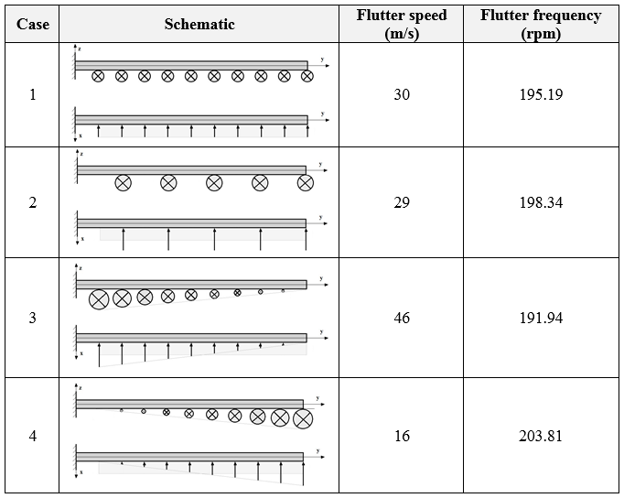
Aeroelasticity of wings with distributed propulsion
Flutter speed and frequency for different arrangement
of distributed engines with the same total thrust
Fazelzadeh et al

Slide 23
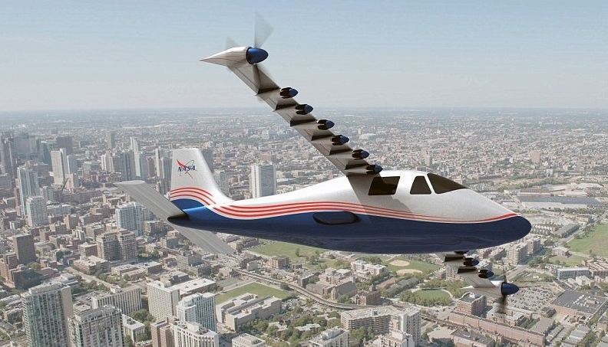
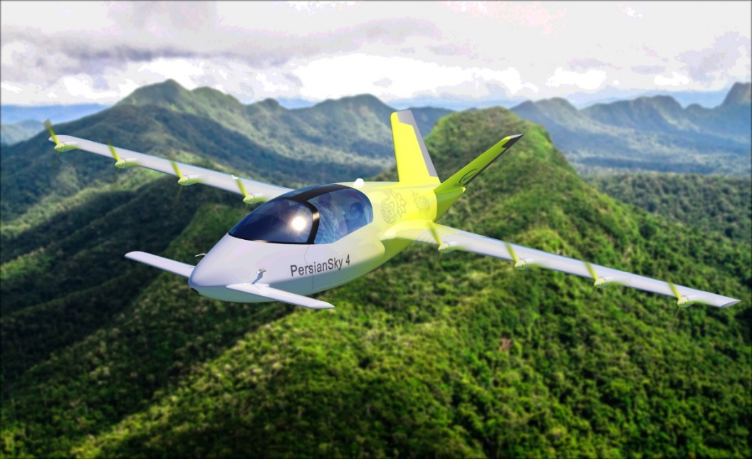
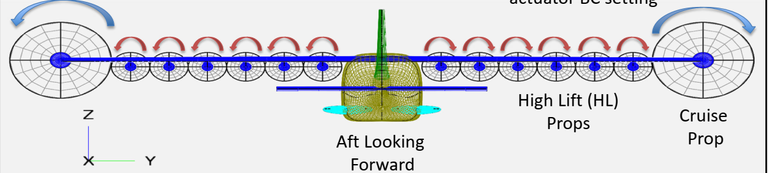
NASA X57 (Tecnam-P2006T) & Persian Sky-IV
DEP Aircraft
Fazelzadeh et al

Slide 24
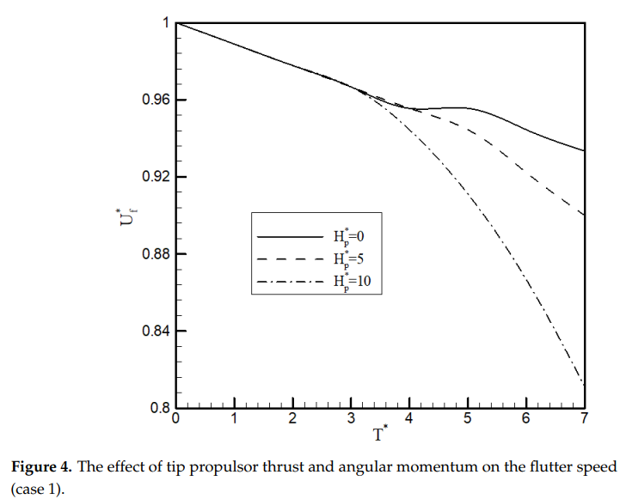
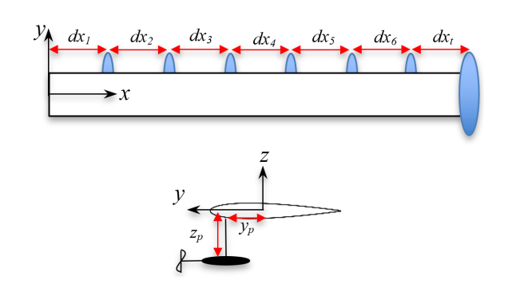
Fazelzadeh et al

Slide 25
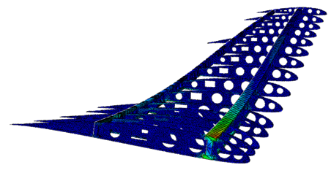
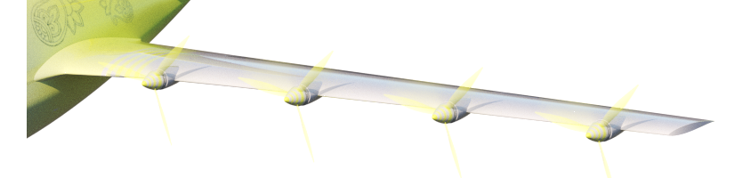
Aeroelasticity of wings with distributed propulsion
Aeroelasticity Analysis of Persian Sky-IV DEP Aircraft Wing
Fazelzadeh et al

Slide 26
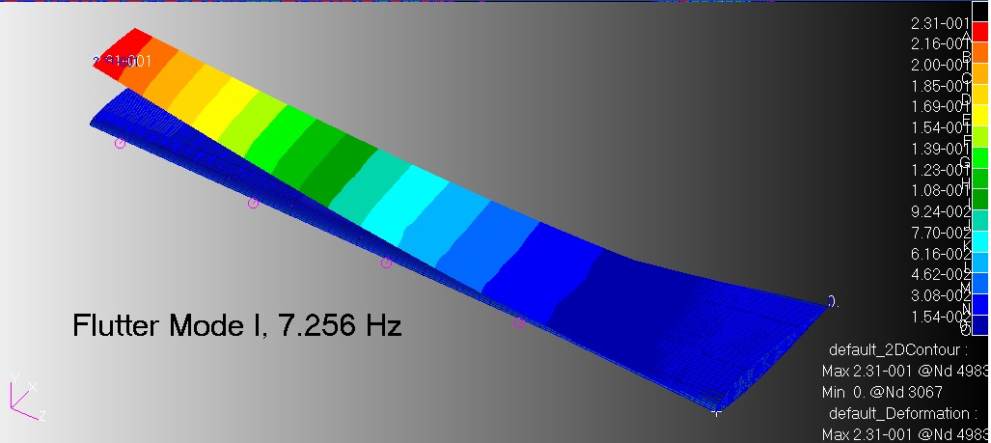
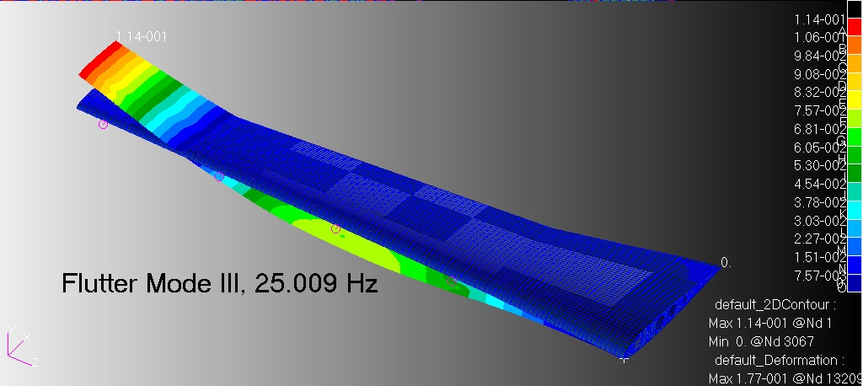
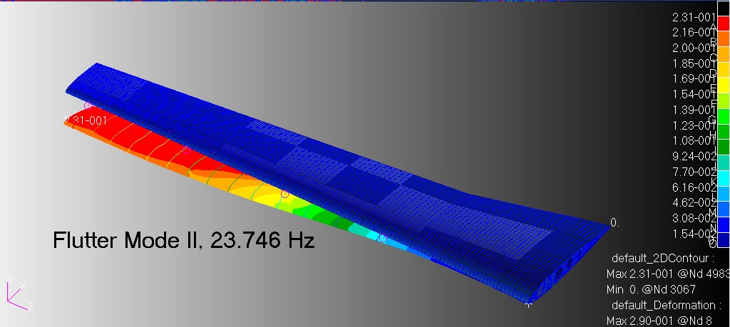
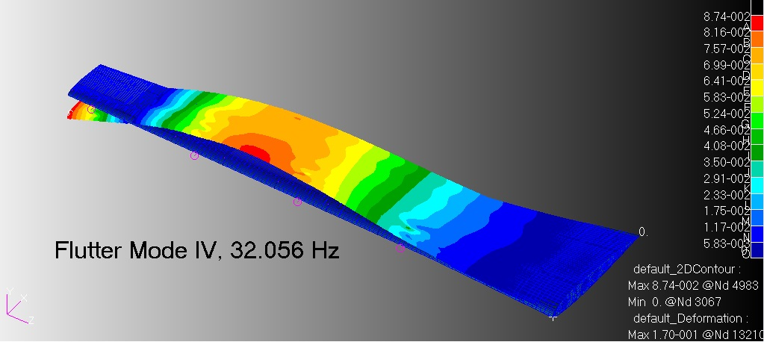
Aeroelasticity of wings with distributed propulsion
Fazelzadeh et al

Slide 27
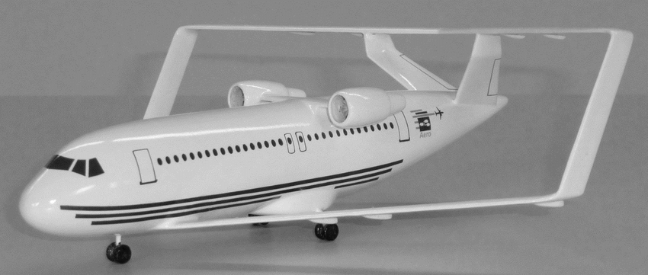
Aeroelasticity of box-wings
The increasing air traffic demands on aircraft capacity, sustainability and profitability, require the investigation of unconventional aircraft configurations with high aerodynamic efficiency.
The application of the box wing system theoretically results in an aircraft configuration generating minimum induced drag.
Box wing aircraft model developed by AERO-Hamburg University
Fazelzadeh et al

Slide 28
Box-Wing Aeroelaticity: Literature Review
A. Mazidi, A.H. Ghasemikaram, S.A. Fazelzadeh, M.R. Amoozgar, Engine Placement Effects on the Flutter of a Medium Range Box-Wing Aircraft, ASCE Under review 2022.
Amirhossein Ghasemikaram, Abbas Mazidi, S. Ahmad Fazelzadeh and Dieter Scholz (2022), Flutter Analysis of a 3-D Box-Wing Aircraft Configuration, International Journal of Structural Stability and Dynamics, (2022) 2250016 (24 pages), DOI: 10.1142/S021945542250016X.
S. Ahmad Fazelzadeh, Dieter Scholz, Abbas Mazidi, Michael I. Friswell, Flutter Characteristics of Typical Wing Sections of a Box Wing Aircraft, AEGATS2018 conference, 23-25 October 2018, Toulouse.
Fazelzadeh et al

Slide 29
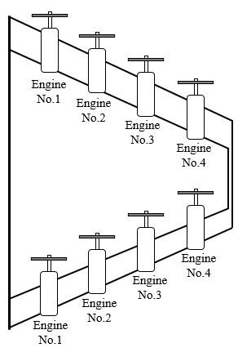
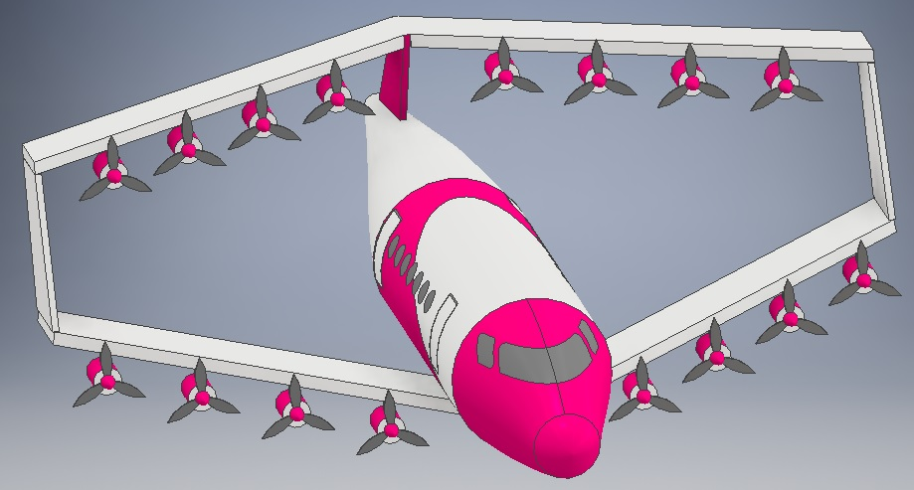
Aeroelasticity of box-wings
Many researches have studied the aerodynamics of BWA, but there is a few knowledge about their aeroelastic behavior.
Fazelzadeh et al

Slide 30
Aeroelasticity of box-wings
The arrangement of engines shutdown is considered in the five situations
First situation: All eight motors are working.
Second situation: Three motors are working on each wing (six motors in total)
Third situation: Four motors are working on one wing (four motors in total)
Forth situation: Two motors are working on each wing (four motors in total)
Fifth situation: One motor is working on each wing (a total of two motors)
Fazelzadeh et al

Slide 31
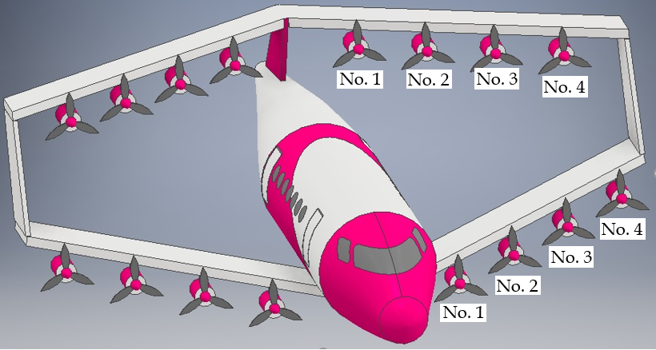
Aeroelasticity of box-wings
First situation: All eight motors are working
The stability boundary
Fazelzadeh et al

Slide 32
Aeroelasticity of box-wings
Second situation: Three motors are working on each wing (six motors in total)
The stability boundary
Fazelzadeh et al

Slide 33
Aeroelasticity of box-wings
Third situation: Four motors are working on one wing (four motors in total)
The stability boundary
Fazelzadeh et al

Slide 34
Aeroelasticity of box-wings
Forth situation: Two motors are working on each wing (four motors in total)
The stability boundary
Fazelzadeh et al

Slide 35
Aeroelasticity of box-wings
Fifth situation: One motor is working on each wing (two motors in total)
The stability boundary
Fazelzadeh et al

Slide 36
Employing distributed electric propulsion, which involves distributing electric motors and associated propulsions along the aircraft wing can improve performance in noise reduction, aerodynamic efficiency, flight reliability and safety.
Aeroelstic characteristics of wings with distributed electric propulsion improve with respect to single or twin engines in the same condition.
It has been observed that the wing equipped with a DEP configuration is more stable than the clean wing.
Our Research team has been developed Persian Sky Program with national and international network. We will appreciate all financial support that could help develop this program.
Conclusion

Slide 37
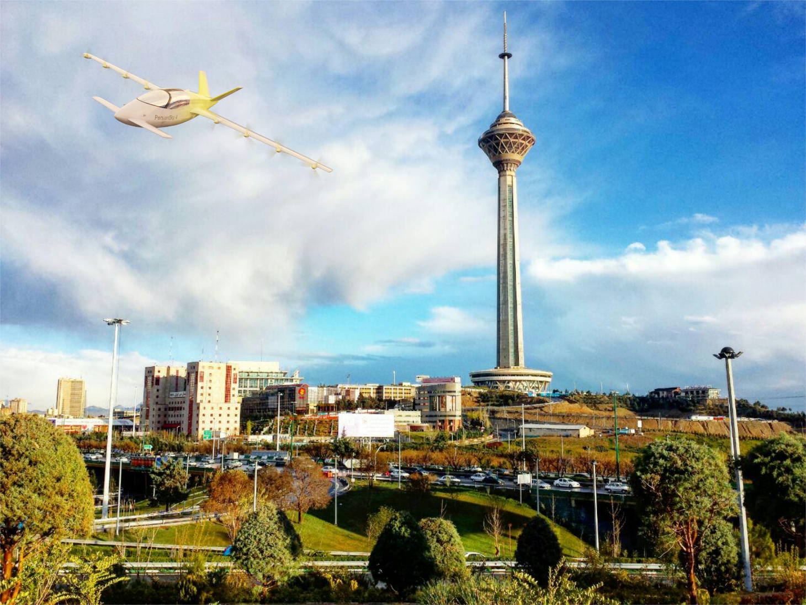
Thank You for Your Attention
Thank you for your attention

